Slide 1
Republic of Serbia
Fiscal Council
ASSESSMENT OF THE FISCAL STRATEGY FOR 2016 AND ISSUES IN THE IMPLEMENTATION OF STRUCTURAL REFORMS
March 2, 2016

Slide 2
Fiscal consolidation and reforms are grinding to a halt and the objectives have not been met
In 2015, the Government faced three main tasks: deficit decrease, public enterprise reform and completion of privatization
Only the fulfilment of all three guarantees a lasting avoidance of the public debt crisis
In 2015, partial success was achieved even though fiscal deficit was decreased more than had been planned
The deficit was decreased from the enormous 6.6% of GDP in 2014 to 3.7% of GDP, but consolidation is not complete
Deficit of 3.7% of GDP does not stop the public debt increase and the Government’s plan (Fiscal Strategy) fails to bring solid, credible measures for further decrease
Public enterprise reforms have barely started in 2015
A good plan for Železnice, but problems arise as soon as first painful measures are encountered, no substantial improvements in EPS and Srbijagas
Resolving the status of enterprises in privatisation is not going as planned
There is certain progress, but only a third of the problems have been resolved (the greatest challenges, actually, still lay ahead)

Slide 3
Where do we go from here: serious measures are necessary
Real work on resolving essential problems in the performance of EPS and Srbijagas needs to start
EPS’s main problems and sources of its poor performance have long been known and it is high time they be faced in earnest
It is necessary to prepare a clear plan and start urgent reform in Srbijagas
There is no excuse for postponement of resolving the status of the majority of enterprises in privatization (Železara, Galenika, Azotara, Simpo...)
In 2016, the status of enterprises employing about 35,000 workers (of about 55,000 still employed in this group of enterprises) would have to be resolved
A solution for RTB Bor and Resavica in 2016 is, by all accounts, very unlikely
The Tax Administration reform needs to finally start and be implemented
There already exists a good plan, and a more efficient suppression of grey economy could increase public revenue by 1% of GDP in medium term
The Government must remain consistent in the strict control of pension and salary increase – this is currently the most important austerity measure and has no alternative

Slide 4
Public enterprise reform is crucial for success
EPS is the largest public enterprise and its poor performance could completely wreak havoc in Serbian public finance
Without the necessary reform, EPS’s large debt (about 1 bn Eur) could fall to the budget, which would be impossible to bear
Reform steps in 2015 were minimal – measures applied were nowhere near sufficient for a substantial improvement in EPS’s performance
The electricity tariff was increased (EPS got only 3%), organisational changes
A big issue in EPS’s operations is the excessive workforce (at least 5-10,000 surplus) and the resolution of this problem is already running late
In 2016, a modest downsize by about 1,000 employees was planned, but not even that is being implemented (collective agreement has not been signed yet: severances)
There are indications that the expenditures for salaries were even increased in 2015
If it did occur, it is irresponsible to increase the salaries in EPS at the expense of the citizens and increase in electricity prices

Slide 5
EPS’s other problems have also yet to be solved
An enormous issue for EPS is that it cannot collect its claims in the amount of 15-20 bn dinars per year for electricity delivered
The majority comes from the fact that RTB Bor, Železara, Petrohemija and other state enterprises are not paying their electricity bills (collection rate is at mere 50%).
The debt of these companies to EPS increased by more than 5 bn in 2015 alone.
Despite the increase in 2015, the electricity tariff is far below the market price and is insufficient for EPS’s sustainable operation
The electricity price paid by households in Serbia is by far the lowest in Europe: the next on the list (Bosnia and Herzegovina) has a 25% higher price
Increase in electricity tariff was a part of the arrangement with IMF, but apparently it is being stalled
tariff increase only makes sense together with other reforms – otherwise, EPS will just spend it in a non-rational manner (2015?)
EPS is suffering great losses due to technical losses in its grid, the reduction of which would bring considerable savings to this enterprise

Slide 6
Srbijagas is by far the largest cost to the budget
For years, Srbijagas has been the largest loss-maker in Serbian economy and these losses come at a high price for the country
Overall debt of Srbijagas has exceeded 1 bn Eur, most of which is guaranteed by the state
Due to Srbijagas’s poor performance, the guaranteed debt is now being paid from the budget (about 200 m Eur per year)
The main reason for Srbijagas’s failing performance is the low collection rate for gas delivered (about 40% cannot be collected)
To prevent this, Srbijagas must stop delivering gas to all those that are not paying their bills
Poor collection created a new issue: merger of the unsuccessful companies with the already failing Srbijagas
The greatest debtors (Azotara, MSK and earlier, Agroživ) have been merged with Srbijagas and are now an additional burden to its balance sheets)
Indisputable state-owned loss-makers have been kept alive at the expense of creating additional problems for Srbijagas

Slide 7
Reforms of Srbijagas have not even started
Unlike for other public enterprises, there is still no plan for the reforms of Srbijagas
In 2015, not even the relatively painless organisational change (harmonization with the European Energy Community legislation) has taken place
In 2015, Srbijagas’s performance will be slightly better due to a sharp prices drop on the global energy markets, i.e. not on its own merits
The price drop increased the collection rate for the current gas deliveries and a part of the old debt of the heating plants has been repaid (in part, also due to a mild winter)
The temporary “respite” was unfortunately not used for substantial improvement of the enterprise’s performance
Gas delivery to debtors has continued (Staklara Paraćin) and the status of loss-makers merged with Srbijagas (MSK and Azotara) has not been resolved
Still, the temporary improvement was used for the payment of a generous bonus to employees (while the citizens pay an enormous price for earlier debts).

Slide 8
Reforms in Železnice started, then paused
For many years, Železnice have been non-profitable and are being kept afloat thanks to state subsidies
Annual budget support is about 100 m Eur and is almost completely used for salaries
A step in the right direction was made in 2015: a status change has been implemented and a good reform plan adopted
The division of Železnice into four companies (for passenger transport, freight transport, infrastructure management and holding company) is in line with good practices
The reform plan aims at the resolution of all burning issues: redundancies, irrational railway network, low prices and collection rate, insufficient investments
The subsidies system has also been improved, now taking efficiency into consideration
However, after the initial success, the implementation of this plan stopped the moment first painful measures were initiated
Indecision and union resistance have postponed the beginning of the planned downsize in 2016, by about 2,700 employees

Slide 9
Resolving the statuses of enterprises in privatisation has been unacceptably slow
Increasing expenditures for the companies in privatization have become an enormous burden for Serbian public finance
Directly or indirectly (through evasion of payments to public enterprises, taxes, contributions etc)
Almost every year some new enterprise comes to depend on budget support for survival
Numerous enterprises survive thanks to the Development Fund loans, which they are not paying back (e.g. Železara Smederevo at the end of 2014, about 100 m Eur)
Resavica receives about 4 bn dinars from the budget every year, which is almost 10,000 Eur per workplace per year
The state has been repaying the guaranteed loan of Galenika for several years, and many others
The long neglect of this problem will lead to unplanned public expenditure increase in the upcoming period as well
Takeover of Petrohemija’s debt to NIS has been announced (85 m Eur) and the payment of RTB Bor’s guaranteed debt will definitely fall to the budget

Slide 10
Fiscal measures insufficient for successful consolidation
A strong public expenditure cut is planned in the Fiscal Strategy, along with the deficit decrease to 1.8% of GDP in 2018, which is a good target
For the deficit to be decreased from 3.7% of GDP in 2015, it would take permanent savings of about 2.3% of GDP as the “true” deficit going into 2016 is a little over 4% of GDP
There are no measures powerful or credible enough supporting the plan, to ensure the planned halt of public debt growth
Downsizing has been unrealistic and doomed to fail from the beginning, so it will not achieve the planned savings (plans too ambitious with no precise analyses)
The pension and salary freeze have already been abandoned and new increases announced
Subsidy reduction has been planned for years, without well prepared measures (agriculture, public media outlets...)
There is a realistic danger of accomplishing only 0.5% of GDP in permanent savings, keeping the deficit permanently at about 3.5% of GDP
The growth of public debt compared to GDP would not stop and Serbia would once again approach a crisis outbreak point

Slide 11
Public debt projections for the Republic of Serbia 2016-2018 1. State enterprise reform with salary and pension freeze (green) 2. No salary and pension freeze (blue) 3. No reform of public enterprises (red)

Slide 12
There is a lack of decisiveness in resolving the status of enterprises in privatization
A modest number of privatizations, small companies mostly sent into bankruptcy
Only a third of the employees (25,000) are no longer paid from the public funds (of which only 2,000 through privatization)
Positive: some large systems undergoing bankruptcy (IMT, IMR, 14. oktobar, Fabrika vagona Kraljevo, Prva petroletka)
This shows that it is possible to reach a firm decision for sensitive enterprises, too
Some decisions are inadequate:
Merger with public enterprises (Military industry, water management)
Predesigned restructuring programs (PRP) instead of bankruptcy
Special statuses (spas, rehabilitation centres)
Sometimes even a bankruptcy is not a final solution: FRA Čačak

Slide 13
In 2016, it is both necessary and possible to at least resolve the status of enterprises with 35,000 employees
20,000 took severance payments
Status of 25,000 employees resolved
2,000 in privatized enterprises
Strategic: 3,000 registered for the social program
80,000 employees at the start of 2015
18,500 in strategic enterprises
7,500 in Kosovo and Metohija
17,000 in water management
Status of 55,000 employees not resolved
2,000 in spas
In rehabilitation enterprises 1,000
No plan
24,000

Slide 14
It is especially important to resolve the status of two groups of the remaining enterprises
1. Eleven so-called strategic enterprises
18,500 employees
Loss-makers, protected from debt collection to private and state-owned creditors
Budget expenditure so far 2 bn Eur
This year, they will cost probably about 200 m Eur; next year, even more (unless privatized/bankrupt)
2. Enterprises with unknown plans and outcomes
11,000 employees in five companies:
Železara, Lasta, Simpo, Azotara, MSK

Slide 15
1. Strategic enterprises
RTB Bor
Total liabilities: 1.2 bn Eur; not paying liabilities to the state and state-owned enterprises; received loans from the Development Fund; activation of the guaranteed debt certain
Price of 4,500 dollars per ton not a precedent
Losses were made even when the price was 9,000 dollars per ton of copper
A PRP is being proposed: the issue of new operational funds

Slide 16
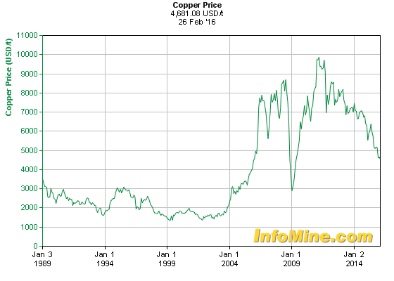

Slide 17
Resavica
Annual subsidies 40 bn Eur (10,000 per employee)
Petrohemija: 10 bn dinars annual loss, not paying its liabilities to NIS, Srbijagas or EPS
Merger with military industry: Yumco and Trayal
Sale not certain: PKB and Galenika
No plans for: FAP, Kablovi Jagodina, Ikarbus, Politika

Slide 18
2. In addition to strategic enterprises, plans not known for other large enterprises as well
Železara
The last subsidy from December 2014 of 13 bn dinars spent?
EU rules limit new state interventions
Simpo: tax debt converted back in 2013, but losses keep accumulating (as much as 400 m Eur from the Development Fund in 2015 alone)
Lasta: debt increase and losses – privatization necessary and possible
Azotara and MSK: debt converted to shares owned by Srbijagas - not a solution, MSK received 600 m Eur from the Development Fund

Slide 19
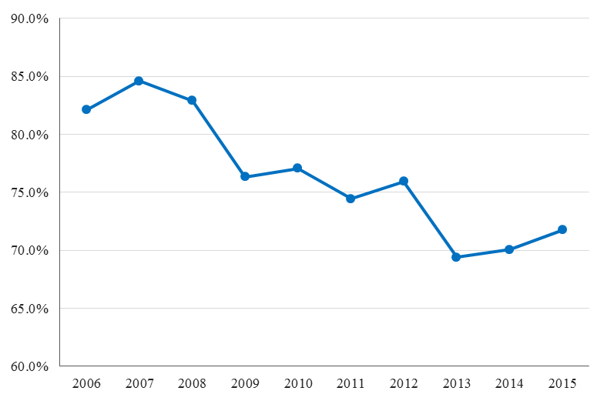
Grey economy suppression
Efficiency of VAT collection
One step forward, two steps back

Slide 20
Combating grey economy
The only possible additional source of revenue
About 1% of GDP in the upcoming three to four years
Possibilities of quick solutions exhausted in 2015
Increase in tax collection will depend critically on system solutions and institutional capacities
Tax Administration, competent courts
The Tax Administration Transformation Program 2015-2020 was a step in the right direction
Developing a powerful and modern institution in terms of staff and operations
However, implementation is difficult and very slow

Slide 21
National grey economy suppression program
Unnecessary and potentially counterproductive strategy
Strategy was developed by unauthorized and incompetent institutions (RSJP and NALED)
Solutions proposed conflict with good practices
Distributed responsibility of state bodies instead of concentrating competences and responsibilities in the Tax Administration
Ineffective populist measures
Municipalities competing in collecting fiscal receipts
Controversial favouring of online fiscalisation

Slide 22
Online fiscalisation
Favoured without previous expert analysis
In 2013, a tender was even opened, then stopped
It would cost the economy and citizens tens of millions of Euros
Especially small enterprises
Croatian experiences are not promising
The profitability study for online fiscalisation was not published together with the National Strategy
Working materials had grave material errors
A transparent, professional debate is necessary
Key to grey economy lies in building Tax Administration’s staff capacities

Slide 23
Reform of Local Self Government Funding
Amendments to the Law on LG Funding from 2011 are harmful
Adopted despite the sharp opposition from the Fiscal Council
Economic structure of local expenditures worsened in the period 2009-2014
Capital expenditures decreased by 28%
Expenditures for goods and services increased by 52%, 34% for employees, 6 bn over the legal salary indexation
Local revenue was 10 bn higher in 2015 than in 2014
The entire increase was spent, mostly in December
Expenditures for salaries at the local level exceeding the legal limits
Ministry of Finance has drafted a new Law on LG funding, but its adoption is running (considerably) late

